Slide 1
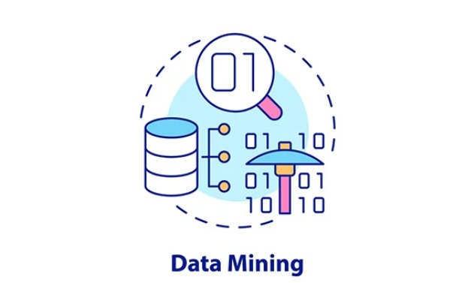
Data Mining Concept

Slide 2
Outline
01
02
04
03
05
Why mine data ?
What is data mining ?
Data mining tasks
Process in data mining
Data mining in applications

Slide 3
Why mine data ?
The data is abundant
The data is being warehoused
The computing power is affordable
The competitive pressure is strong
Data mining tools have become available

Slide 4
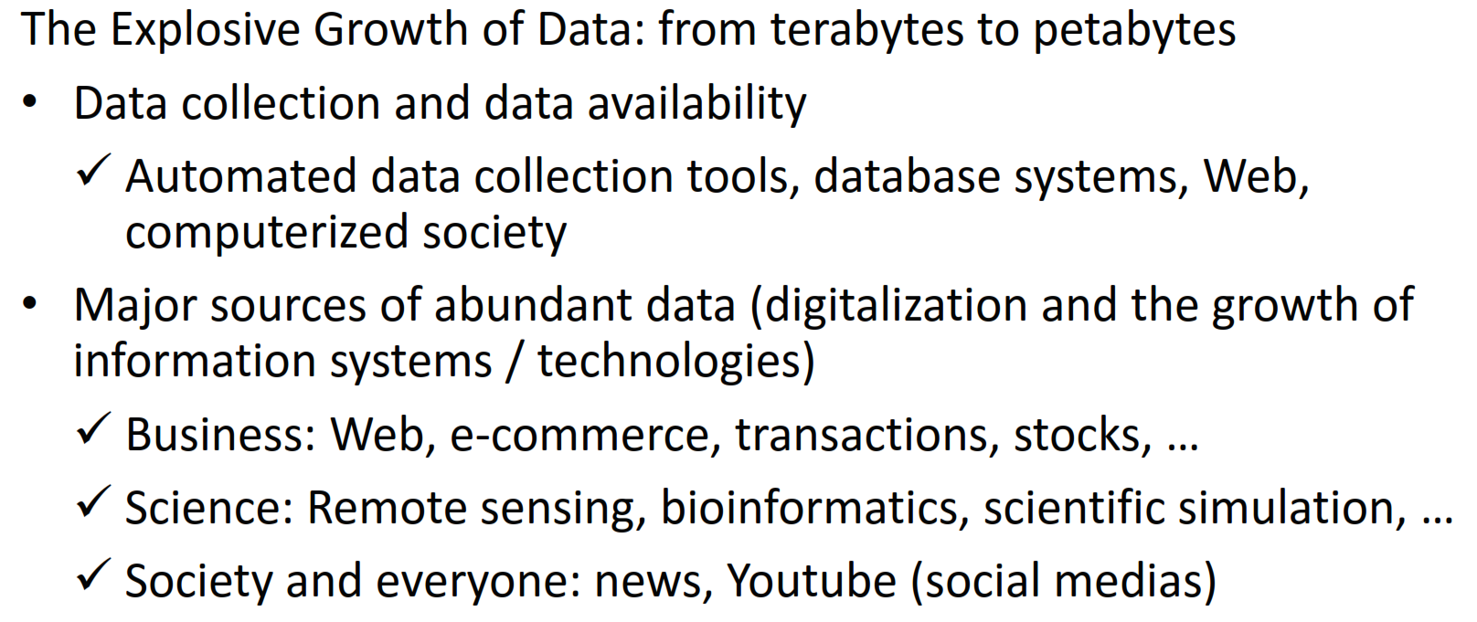
Why mine data ?

Slide 5
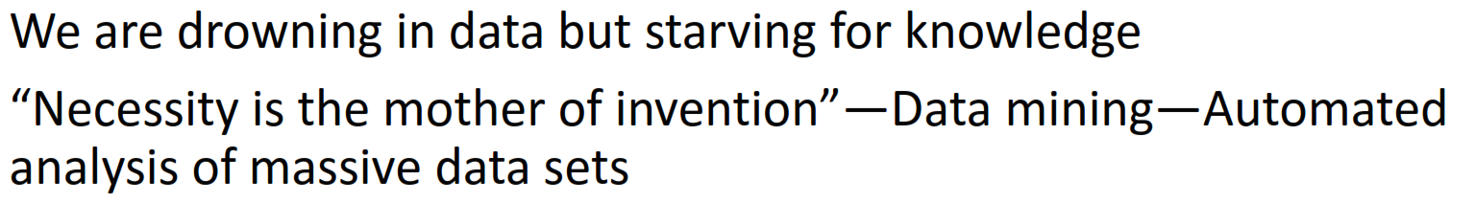
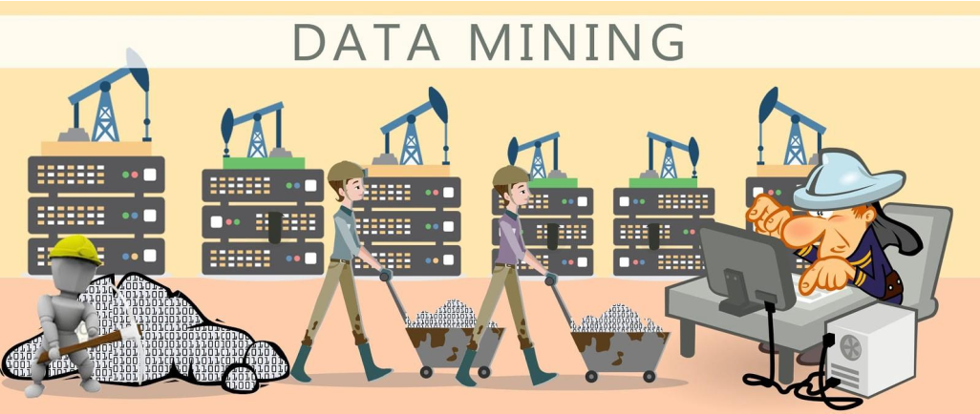
Why mine data ?

Slide 6
What is Data Mining ?
Data mining (knowledge discovery from data)
Extraction of interesting (non-trivial, previously unknown and potentially useful)
patterns or knowledge from huge amount of data
In simple term → Data mining = finding hidden patterns in large data.
Alternative names
Knowledge discovery (mining) in databases (KDD), knowledge extraction, data/pattern analysis, data analytics (context dependent), business intelligence, etc.
Watch out: Is everything “data Mining” ?
Simple search and query processing
(Deductive) expert systems
Notes:
discovering new, non-trivial (bukan hal sepele), previously unknown patterns from large data.
In simple terms: Data mining = finding hidden patterns in large data.
Data archaeology → exploring ancient ruins to understand history
Data dredging → fishing blindly until something bites
Information harvesting → farming crops intentionally
Not every data-related activity should be called data mining.

Slide 7
1️⃣ Simple search and query processing
SQL queries
Filtering records
Retrieving data
Keyword search
✅ retrieve known information ❌ do NOT discover new knowledge
← Not Data Mining
2️⃣ (Deductive) Expert Systems
An expert system is a rule-based AI system where:
rules are written by human experts
system applies those rules
conclusions are logically deduced
System behavior:
rules are predefined
knowledge is already known
no learning from data
← Not Data Mining
🔍 Why it is different
Data mining emphasizes:
automated discovery from data
Expert systems emphasize:
human-encoded knowledge

Slide 8
✅ Data mining = discovery
finds hidden patterns
learns from data
produces new knowledge
❌ Query processing = retrieval
fetches existing data
no learning
no new knowledge
❌ Expert systems = rule application
uses human-written rules
deductive reasoning
no pattern discovery

Slide 9
Question
Which of the following is an example of data mining?
Running an SQL query to list all customers from Jakarta
A rule-based medical expert system diagnosing flu
Using K-Means to segment customers into groups
Filtering transactions where amount > 1,000,000
Notes:
K-Means clustering ✅
Automatically discovers hidden structure
Finds unknown customer groups 👉 True data mining

Slide 10
Question
A company builds a model using historical data to predict whether a customer will churn. What is this?
Query processing
Expert system
Data mining
Database retrieval
Notes:
✅ Answer: C. Data mining
Why: the model learns patterns from data.

Slide 11
Question
An analyst tests 500 different correlations and reports only the significant ones. This practice is called:
Information harvesting
Data archaeology
Data dredging
Feature engineering
Notes:
✅ Answer: C. Data dredging
Why: Because the analyst is searching blindly through many tests without a prior hypothesis, which greatly increases the chance of finding false significant results by luck.
4 point diatas Adalah bukan data mining

Slide 12
Both methods search data — so what’s the danger?

Slide 13
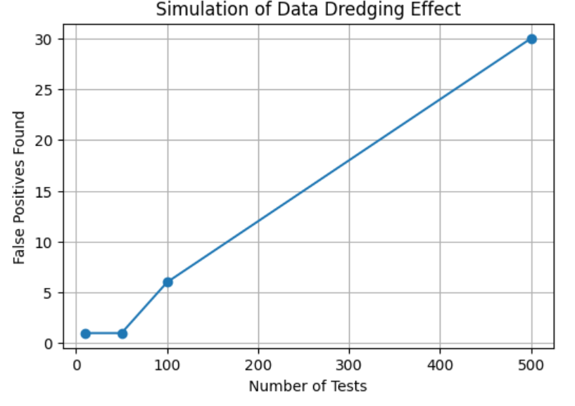
Example
Data Dredging Simulation
https://colab.research.google.com/drive/1i92JEuuqsuDJ_kCx9jFHh1k-6RZ-RKiT#scrollTo=bf6045e3

Slide 14
Example
Data Mining example
https://colab.research.google.com/drive/15sw7MSzcAjEH8SLWDSTjV7Wsf_JjAnAd#scrollTo=8c94116b

Slide 15
⚠️ Distinguishing Data Mining from Data Dredging
Data Mining: systematic and validated discovery of meaningful patterns from data
Data Dredging: indiscriminate searching for statistically significant results without proper validation
Key Risk: Data dredging greatly increases false positives and misleading conclusions
Best Practice: always use train/test split, cross‑validation, and hypothesis discipline

Slide 16
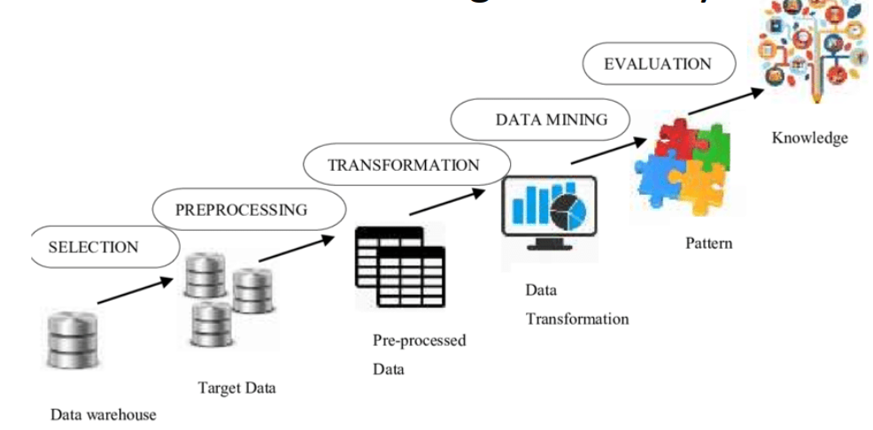
Knowledge Discovery (KDD) Process
This is a view from typical database systems and data warehousing
communities
Data mining plays an essential role in the knowledge discovery
Process
Notes:
Sebenarnya data mining merupakan salah satu step atau tahapan pada proses besar “knowledge discovery”

Slide 17
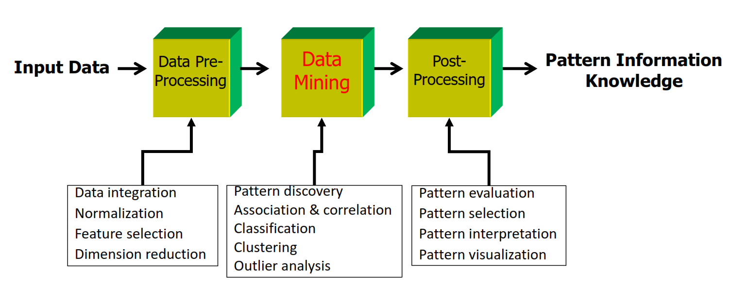
KDD Process: A Typical View from ML and Statistics
This is a view from typical machine learning and statistics communities

Slide 18
Data Mining Tasks
Supervised Learning (with Label)
→ Learn from labeled data to predict outcomes.
🔹 Classification: Predict categorical label
Goal → Predict Class
Algorithm:
Decision Tree
Logistic Regression
SVM (Support Vector Machine)
Neural Network
Example:
Fraud detection
Disease diagnosis
Spam detection

Slide 19
Data Mining Tasks
Supervised Learning (with Label)
→ Learn from labeled data to predict outcomes.
🔹 Regression : Predict numeric value
Goal → Predict Value
Algorithm:
Linear Regression
Random Forest
Gradient Boosting
Example:
House price prediction
Sales forecasting

Slide 20
Data Mining Tasks
Unsupervised Learning (No Label)
→ Discover hidden structure in data.
🔹 Clustering: Group similar instances
Goal → Group data
Algorithm:
K-Means
Hierarchical Clustering
DBSCAN
Example:
Customer segmentation
Document grouping

Slide 21
Data Mining Tasks
Unsupervised Learning (No Label)
→ Discover hidden structure in data.
🔹 Association Rule Mining: Discover co-occurrence patterns
Goal → Find patterns
Example:
Market basket analysis
Algorithm:
Apriori
FP-Growth

Slide 22
Data Mining Tasks
Unsupervised Learning (No Label)
→ Discover hidden structure in data.
🔹 Anomaly Detection: Detect unusual observations
Goal → Find rare events
Example:
Fraud detection
Network intrusion
Algorithm:
Isolation Forest
LOF

Slide 23
Data Mining Tasks
Unsupervised Learning (No Label)
→ Discover hidden structure in data.
🔹 Dimensionality Reduction: Reduce features while preserving information
Goal → Simplify data
Example:
Visualization
Preprocessing
Algorithm:
PCA
t-SNE
UMAP
Notes:
If we know the answer (label), what type of learning is it? Supervised
If we don’t know the answer? Unsupervised

Slide 24
Data Mining Tasks
https://colab.research.google.com/drive/1c6Ay25O4lOX_CZJ0ntJK8fibM2x1Hsku#scrollTo=d25dd739

Slide 25
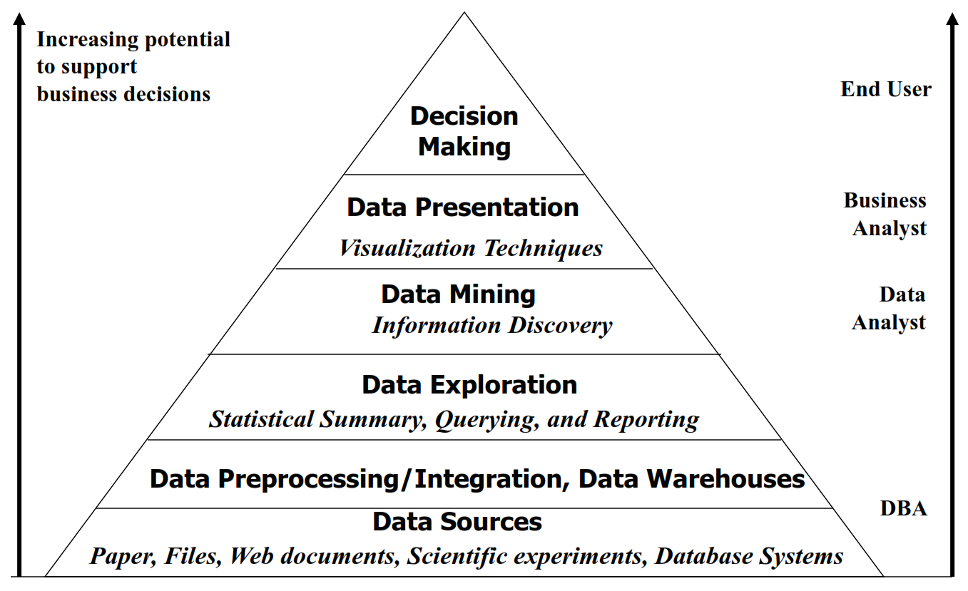
Notes:
Why is data mining not the final goal? Because data mining is only one layer.
The final goal is: Decision Making.
Data mining is powerful, but by itself it does not create business value. Value is created when insights are translated into decisions.
Piramida ini menunjukkan bagaimana data mentah di bagian bawah diubah langkah demi langkah menjadi keputusan bisnis di bagian atas.
Penambangan data bukanlah titik awal dan bukan pula titik akhir — ini adalah salah satu tahapan penting dalam proses penemuan pengetahuan.
Semakin tinggi kita naik, semakin terstruktur, disempurnakan, dan berharga informasinya.
Ini Adalah versi lama

Slide 26
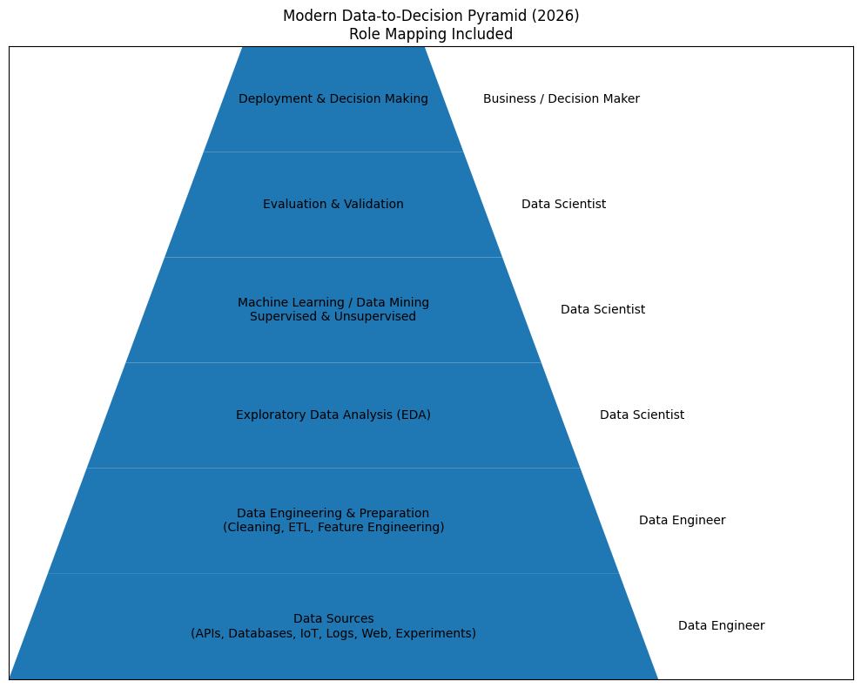
Notes:
Ini versi terbarunya
Data Engineers make data usable. Data Scientists extract patterns and build models. Business leaders use validated results to make decisions.

Slide 27
Thanks!

